Slide 1
Kinloch Lake
Depth Measurements
5-8-2019
7-12-2019
7-19-2019

Slide 2
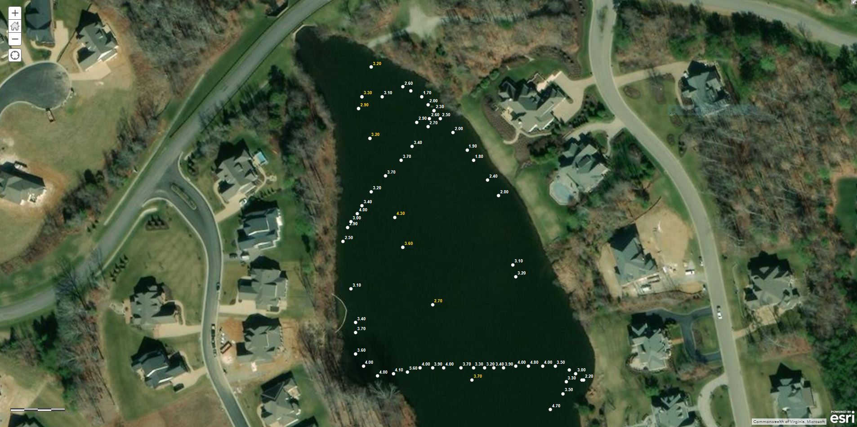

Slide 3
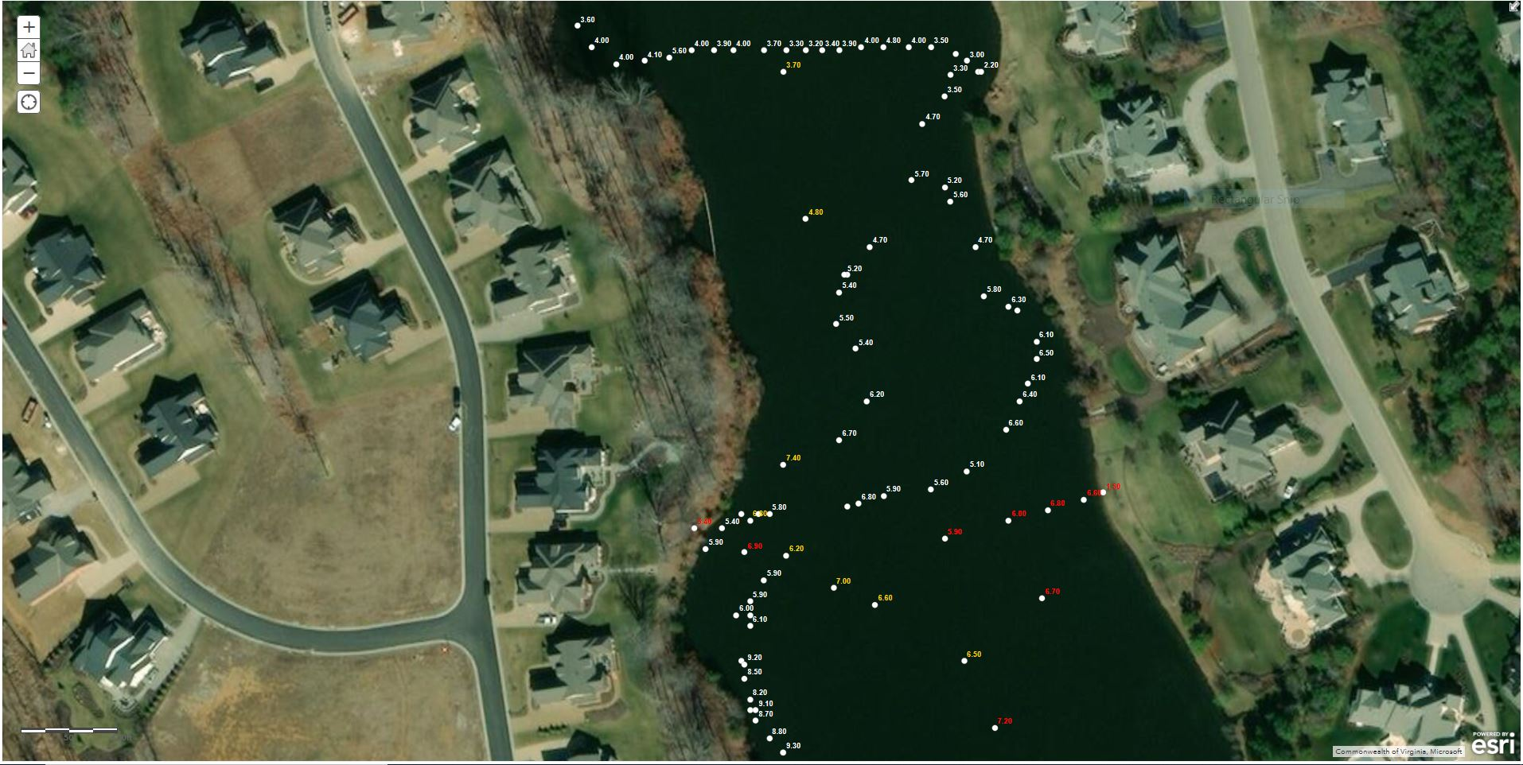

Slide 4
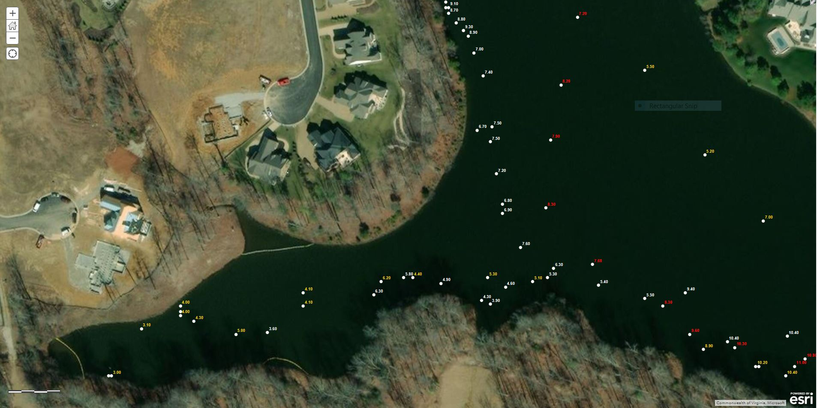

Slide 5
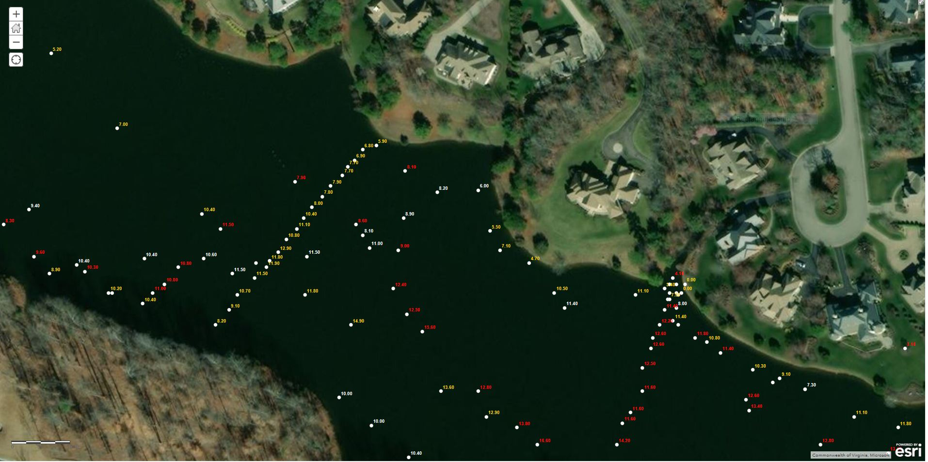

Slide 6
